Slide 1

Android Chess Game App
By: Yusuf Wong
Notes:
So this was an assignment that I submitted as my final project for my Software Design Engineering Class. I was asked by my professor to use all the knowledge I learned about Java from his class and create a simple Android App Application. Being ambitious and wanting to have something noticeable on my resume, I wanted to rewrite the game of chess from scratch using Java and its Object-Oriented-Programming techniques like abstraction, inheritance, encapsulation, and polymorphism.

Slide 2
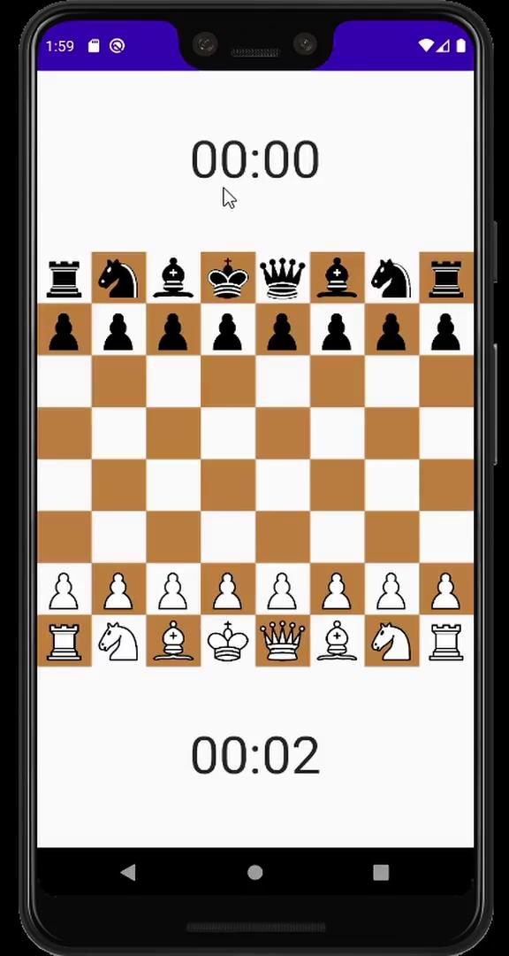
VIDEO
DEMONSTRATION
https://drive.google.com/file/d/1ftf2Ryv8Ye7OHuPZUbCGYWZchZeDDUCY/view?usp=sharing

Slide 3
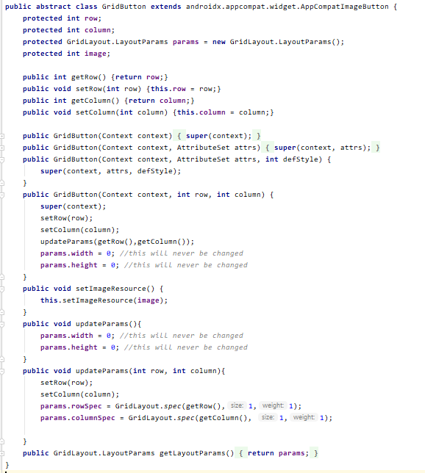
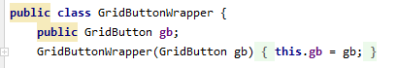
Data Structures Used:
Customized my own grid Button that had specific information such as:
Row
Column
Image (if any, or else 0/null!)
Layout params that contain row & column info that can EASILY be manipulated!
Created an 8x8 2D array of GridButton WRAPPERS, so that each button on the board can be swapped/changed with ease (see next slide for more details!)
Notes:
Before I started this project, I first struggled to understand what type of 2-D Datastructure I should be using, until I researched using Google and StackOverflow similar projects like checkers and minesweep. I had to use a 2D dynamic array of GridButton Wrappers to swap objects or pieces on the chessboard because in Java, objects are passed by value instead of reference, like C++.

Slide 4
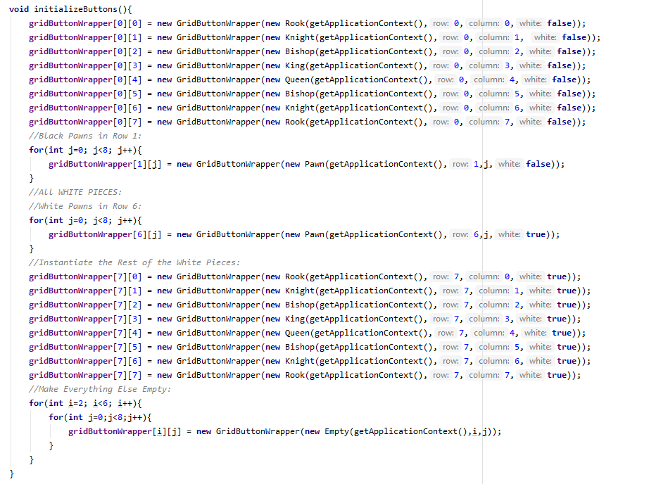
Data Structures Used Contd:
Initialized all the grid buttons on the Board in the following manner 🡪
[0][0] represents top left corner of the board & [7][7] represents the bottom right corner
Note that all the buttons that do not represent a chess piece are initialized as empty pieces! (basically null piece with a null resource image!)
Each piece requires to be either white or black

Slide 5
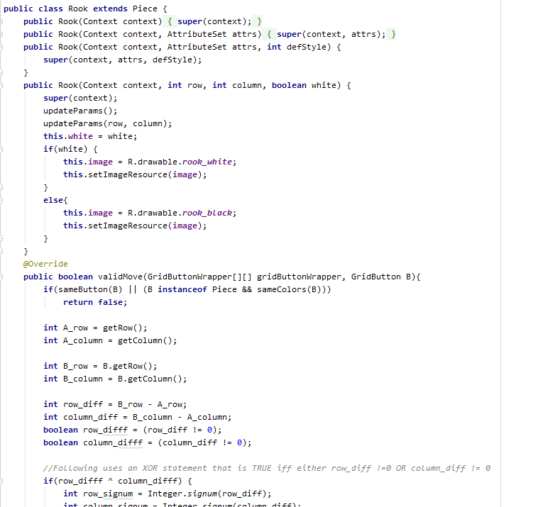
Data Structures Used Contd – Rook Piece Example
Created an Abstract Class called Piece that must specify a specific type of piece (i.e. queen, rook, bishop, etc) when a new piece is created
It’s contains a params variable that specifies the row and column information

Slide 6
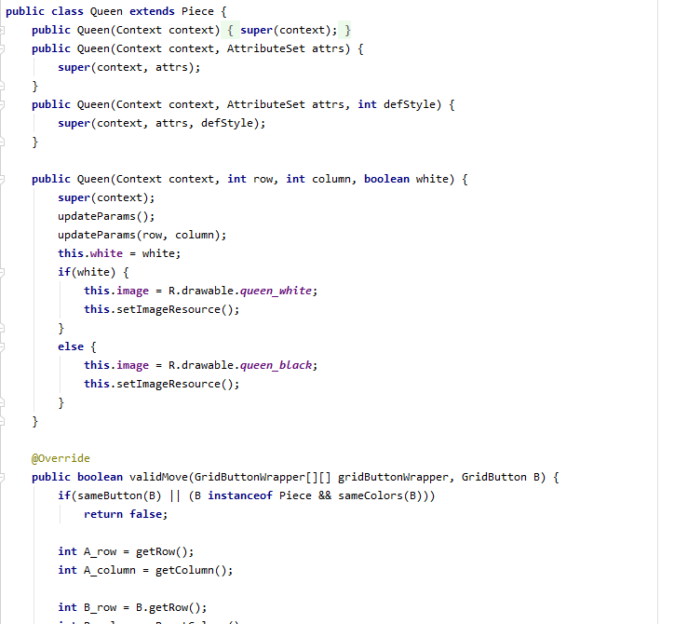
Data Structures Used Contd – Queen Piece Example
Created an Abstract Class called Piece that must specify a specific type of piece (i.e. queen, rook, bishop, etc) when a new piece is created
It’s contains a params variable that specifies the row and column information

Slide 7
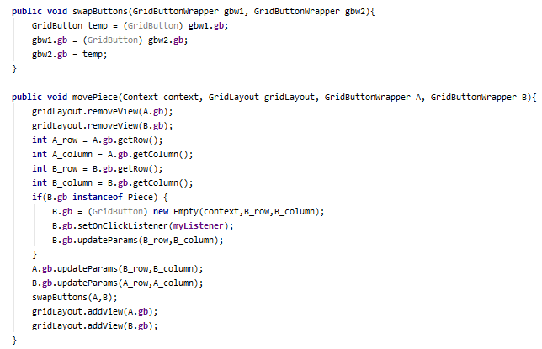
Data Save/Retrieval Methods:
Created two functions to basically swap pieces/gridButtons on the board with ease 🡪
Notes:
Used a wrapper, abstract class called GridButtonWrapper to “wrap” different types of abstract pieces, like Rooks, Queens, null/empty spots, etc and to easily swap them whenever needed. This is because in Java, the information about each object is passed by value, not by reference, unlike C++. In C++, it would’ve been easier because then I could’ve swapped pointers and updated the parameters of each object much more easily, than having to create a wrapper in Java.

Slide 8
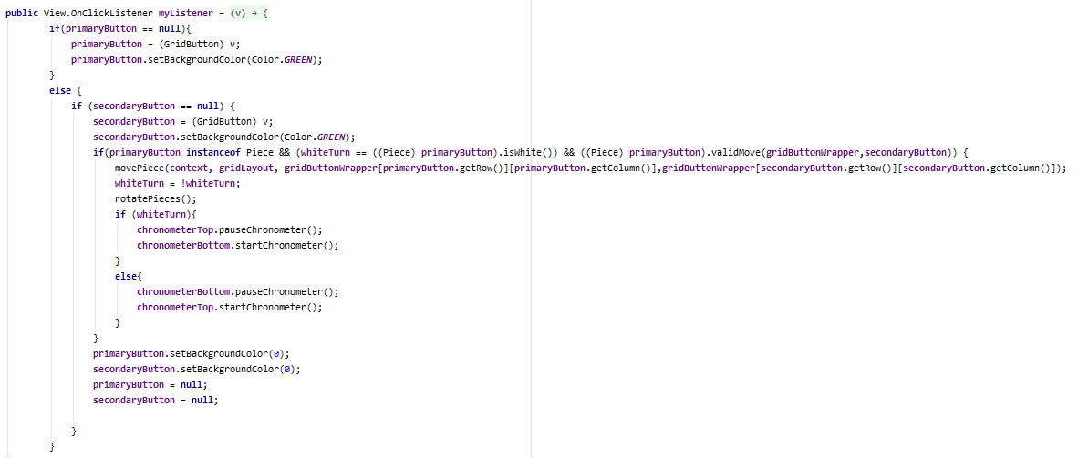
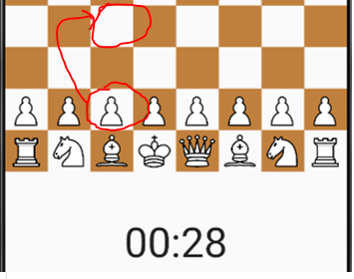
Data Save/Retrieval Methods Contd:
Employed Listener function for each button that is clicked move pieces on the board

Slide 9
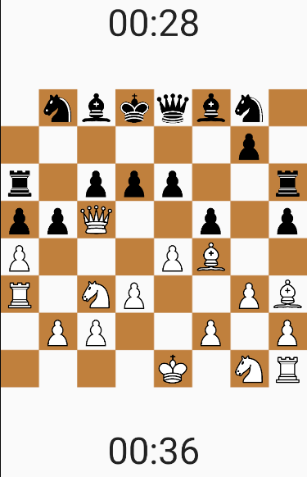
Implemented Features:
All Chess Pieces Move Correctly!
Feel free to try out any piece by clicking 2 valid buttons (i.e. move set) on the board!
See Example Here: https://drive.google.com/file/d/18Rz0ZklvXFW5azLTOus4lhAAhnOh3mxH/view

Slide 10
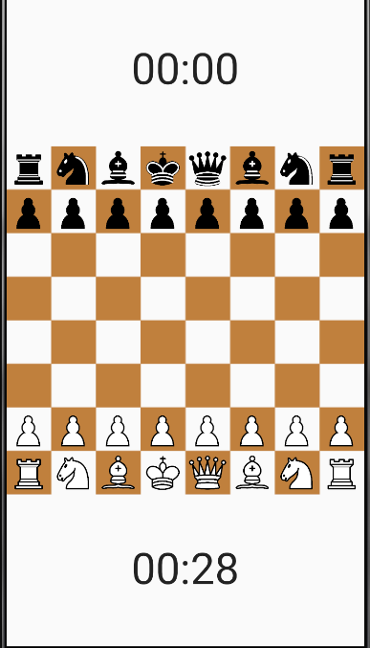
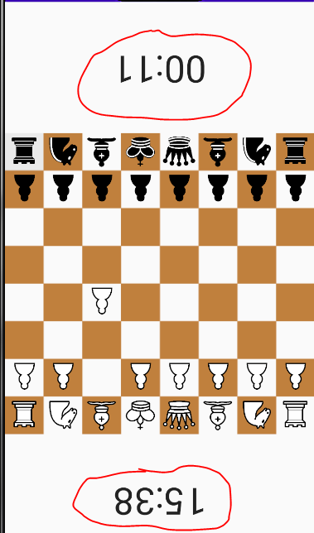
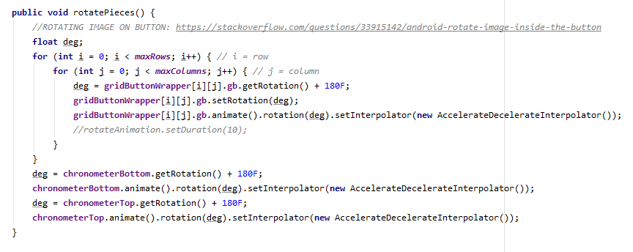
Implemented Features Contd:
Chronometer (timer for each player’s turn) & Rotation (all pieces & Chronometers rotate so opposing player can play!)

Slide 11
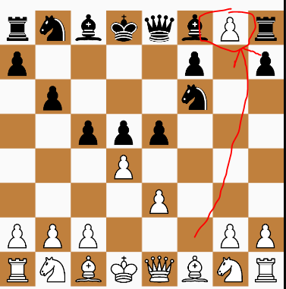
Missing Features & Drawbacks
No undo button (unfortunately)
No Restart/Reset Board button (users must restart app to restart game)
No check/checkmate (users must check each other’s kings themselves)
This part was hard because I’d have to check all the opponent’s pieces and see if it’s position can directly attack the king
Check Mate is even harder because it needs to assess at least 1 counter move out of all possible moves that would allow the king to get OUT of check (this requires a lot of excess coding, perhaps even dynamic algorithms??)
Pawn doesn’t convert to Queen at the end of the board, as shown in the following image 🡪

Slide 12
Challenges I’ve Overcome
Biggest challenge was understanding the architecture of Android (such as which objects I had to use to design this game from scratch) and determining the best data-structure to dynamically implement (without much coding/messing around with the xml file) and organize all the 64 buttons on the board.
It took me several days to figure out that I simply had to create a GridLayout.LayoutParams params variable for each instance of my customized gridButton. Only then could I easily specify and dynamically change the row and column of any button on the board!
Another big challenge was experimenting with switching buttons. I initially had problems swapping buttons (i.e. a rook with a blank or eating an opponent’s piece) until I spent a few more days experimenting with gridButton WRAPPERS, which basically made all the moves on the chessboard POSSIBLE! (by swapping pointers to gridButtons with ease!)

Slide 13
What I Learned from this Process
LEARNING how to google/search on stackoverflow and EXPERIMENTING with code is a MUST! I learned to be more patient when trying to find the data structure I needed to create the chess game engine for this project
Finally understood what a wrapper is in Java (allows to swap pointers to objects with ease!)
Understood how to manipulate/customized my own grid Buttons by incorporating my own params and image variables associated with each type of piece/null piece
Learned how to organize classes and subsets/children of classes (i.e. creating an abstract Piece class within an abstract grid Button class [as shown in the code])
Don’t let perfectionism impede the main goal of a project. I fell into the trap of trying to make my project behave exactly as any other chess game engine. Even after completing my project, I realized I didn’t have time to incorporate the check/checkmate portion of chess because of the lack of time.

Slide 14
Features I would’ve added, if given more time:
Really wished I had time to add the check/checkmate portion of the game. I spent several weeks coding/organizing the data structure of the game engine itself, but didn’t have the time to really understand how to make sure that the opponent’s king is in check and that the opponent had to make a valid move to get out of check before the next user’s turn
Allow the pawn to convert to a Queen (when reaching the other end of the board)
Undo Button (allow user to undo a move)
Reset Button (reset/reinitialize pieces on the board)

Slide 15
THANK YOU & STAY SAFE!!!

